Slide 1
Module:6
Semi structured & Unstructured data base

Slide 2
DATA
Known facts that can be recorded and have an implicit meaning
Descriptions, observations and numbers used in decision making.
Big data- deals with large amount of data
Structured
Semi structured
Unstructured Data

Slide 3
Structured data
Data whose elements are addressable for effective analysis
Organized into a formatted repository that is typically a database
Concerns all data which can be stored in database
Concerns all data which can be stored in database SQL in a table with rows and coloumns
Have relational keys and can easily be mapped into pre-designed fields
Example: relational data

Slide 4
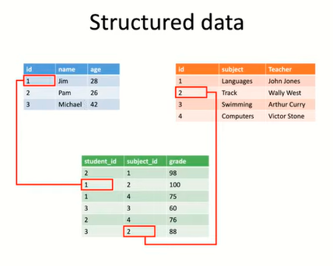

Slide 5
Semi-structured data
Information that does not reside in a relational database
Have some organizational properties that make it easier to analyze
With some process, you can store them in the relational database
Example: XML data, JavaScript Object Notation (JSON), HTML files

Slide 6
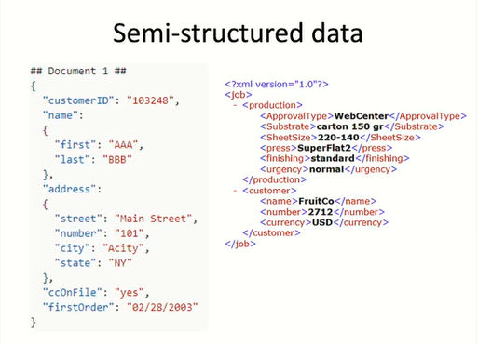

Slide 7
Unstructured data
Data which is not organized in a predefined manner
Does not have a predefined data model
Not a good fit for a mainstream relational database
Used by organizations in a variety of business intelligence and analytics applications
Example: word, pdf, text, media logs

Slide 8
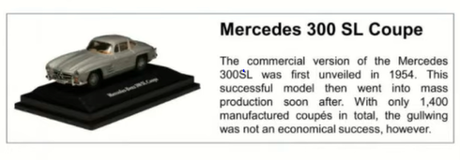

Slide 9
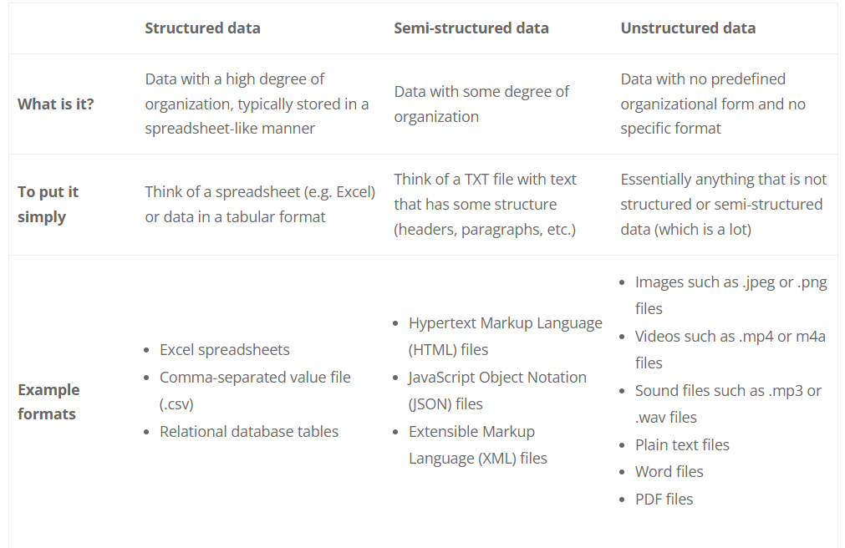

Slide 10
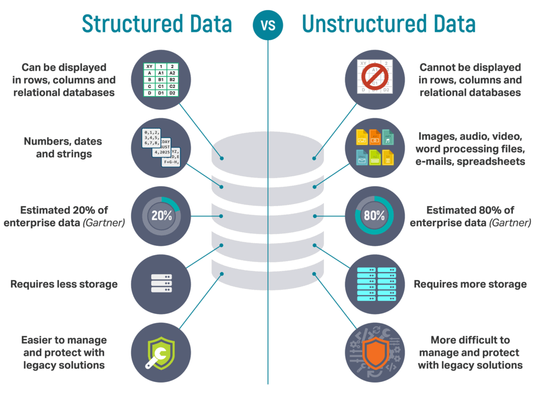

Slide 11
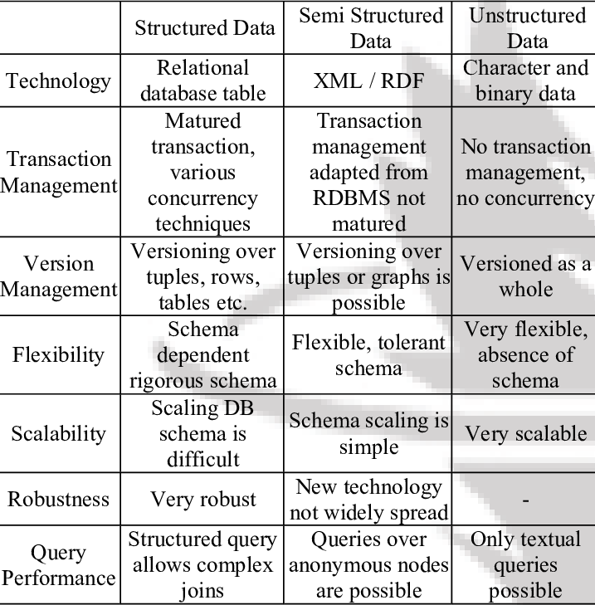

Slide 12
Semi-Structured Data model
Data is collection of nodes (leaf or Interior)
Leaf has data (atomic type- numbers and strings)
Interior- Arcs with lables
Root node has no incoming arcs(interior node)

Slide 13
Company(&1)
Department(&2)
dname (&7)"Estate"
Manager &3
empl (&3)
name (&8)
fname (&17) "John"
lname (&18) "Smith"
managerOf &2
empl(&4)
name (&9) "James Borg"
salary (&10) 60000
manages &5
manages &6
project (&5)
pname (&11) "Reorganization"
type (&12) "Inhouse"
monthlyCost (&13) 4000
managedBy &4
project(&6)
pname (&14) "Computerization"
type (&15) 1
annualCost (&16) 40000
managedBy &4

Slide 14
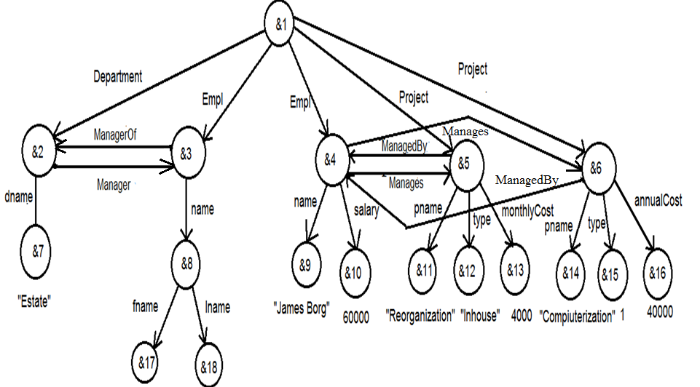
Graphical representation of semistructured data
Company

Slide 15
Object Exchange Model (OEM)
One of the proposed models for semistructured data is the
Object Exchange Model (OEM)
OEM is a nested object model
Data in OEM is schema-less and self-describing, and
can be thought of as a labeled directed graph where the
nodes are objects

Slide 16
OEM
An OEM object consists of
a unique object identifier,
a descriptive textual label,
a type and
a value

Slide 17
OEM
Objects are decomposed into atomic and complex.
An atomic object contains a value for a base type.
Examples of OEM objects
{empl, &4, set, {&5, &6}}
{name, &9, string, “James Borg”}
{salary, &10, decimal, 60000}

Slide 18
Lore & Lorel
Lore (Lightweight Object Repository) is a multi-user
DBMS based on OEM
Lore has been modified to handle XML
Lorel (Lore Language) is a query language for Lore.
Lorel supports path expression to answer query
e.g. company.department.dname is a path expression

Slide 19
Lorel
Lorel is similar to SQL
Find all employees with salary higher than 40000
Select company.employee where
company.employee.salary > 40000
Find out name of employees and their department name with salary higher than 40000
Select company.employee.name,
company.department.dname
where company.employee.salary > 40000

Slide 20
XML
XML (eXtensible Markup Language) is a markup language
that allows its designers to create their own tags.
XML is a restricted version of SGML (Standard
generalized markup Language).
XML is less complex than SGML
XML can store and manage semi-structured data.
XML data may or may not have schema.

Slide 21
Advantages of XML
Simple
Platform and vendor independent
Extensible
Reuse
Separation of content and presentation
Improved load balancing
Support for integration of data from various sources
Ability to describe data from a variety of applications

Slide 22
Overview of XML
XML declarations
Elements
Attributes
Entity references
Comments
CDATA section & processing instructions
Ordering

Slide 23
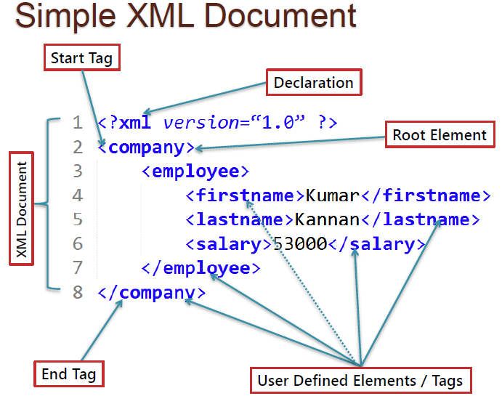

Slide 24
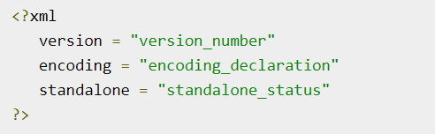
XML Declaration
Parameter | Parameter_value | Parameter_description
Version | 1.0 | Specifies the version of the XML standard used.
Encoding | UTF-8, UTF-16, ISO-10646-UCS-2, ISO-10646-UCS-4, ISO-8859-1 to ISO-8859-9, ISO-2022-JP, Shift_JIS, EUC-JP | It defines the character encoding used in the document. UTF-8 is the default encoding used.
Standalone | yes or no | It informs the parser whether the document relies on the information from an external source, such as external document type definition (DTD), for its content. The default value is set to no. Setting it to yes tells the processor there are no external declarations required for parsing the document.

Slide 25
An XML document
<?xml version = "1.0" encoding = "UTF-8“ standalone = 'no"?>
<?xml stylesheet type ="text/xsl" href = "empl_list.xsl"?>
<!doctype empllist system "empl_list.dtd">
<empllist>
<empl dno = "5">
<ssn>123456789</ssn>
<name>
<fname> John </fname>
<lname> Smith </lname>
</name>
<dob>01-jan-1990</dob>
<salary>60000</salary>
</empl>
<empl dno = "1">
<ssn>888665555</ssn>
<name>
James Borg
</name>
<salary>80000</salary>
</empl>
</empllist>
An XML document

Slide 26
XML rules
An XML document should start with the XML
declaration; for example,
<?xml version = “1.0”?>;
All elements must be contained within one root
element;
Elements must be nested in a tree structure
without any overlap;
All non-empty elements must have a start-tag
and an end-tag.

Slide 27
Ordering of tags & attributes
<NAME>
<FNAME>John</FNAME> <LNAME>White</LNAME>
</NAME>
<NAME>
<LNAME>White</LNAME> <FNAME>John</FNAME>
</NAME>
<NAME FNAME = "John" LNAME = "White"/>
<NAME LNAME = "White" FNAME = "John"/>

